Slide 1

分布式训练系列
数据并行
ZOMI

Slide 2
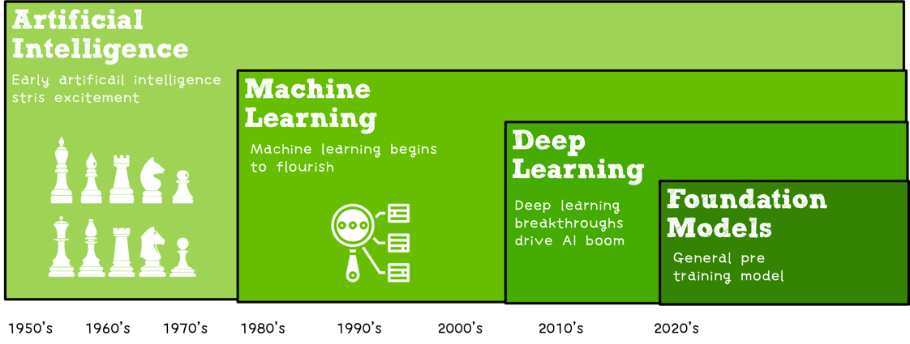

Slide 3
关于本内容
内容背景
大规模分布式训练系统：串行到并行 – 并行处理体系 – 深度学习并行训练
具体内容
大模型训练的挑战：内存墙 – 性能墙 – 效率墙 – 调优墙
分布式训练系统：并行处理硬件架构 – 业界分布式系统分析
分布式并行总体架构：参数服务器模式 – 集合通讯模式
通信原语与协调：通讯协调软硬件 - 通信实现方式 - 通信原语
大模型算法结构：大模型算法发展 – NLP大模型 - CV大模型 – 多模态大模型
分布式并行：数据并行 – 模型并行 – 流水并行 – 混合并行
内存和计算优化：ZeRO内存优化 – 混合精度与计算优化

Slide 5
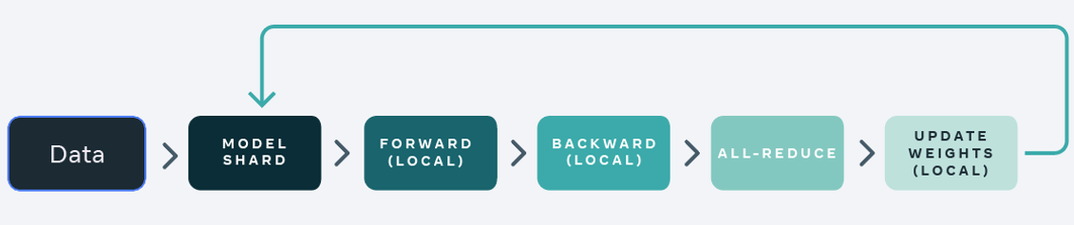
Data parallelism
Data parallelism, DP
Distribution Data Parallel, DDP
Fully Sharded Data Parallel, FSDP

Slide 6
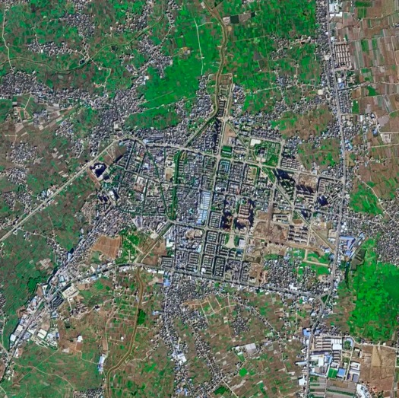
Data parallelism
Data parallelism, DP
Distribution Data Parallel, DDP
Fully Sharded Data Parallel, FSDP
256 x 256 x 3
24599 x 35688 x 256

Slide 7
Data parallelism, DP
Data Parallel automatically splits training data and sends model jobs to multiple GPUs. After each model completed, Data Parallel will Accumulate Gradients.
Notes:
DataParallel 自动分割你的数据，并将作业订单（job orders）发送到多个GPU上的多个模型。每个模型完成工作后，DataParallel 会收集并合并结果，然后再将结果返回给你。

Slide 8
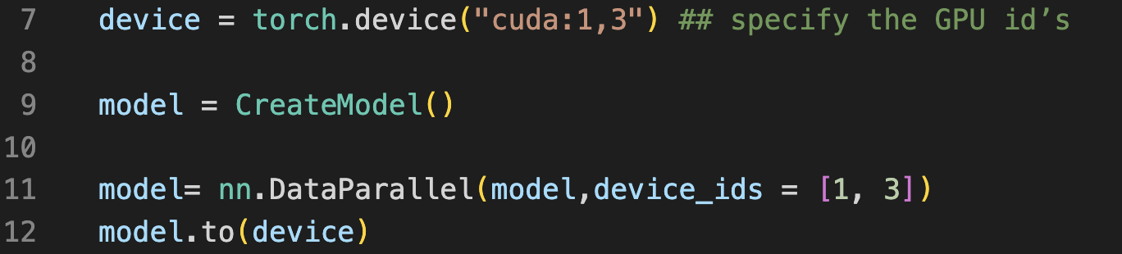
Data parallelism Limitation(I)
Practice
Simple implementation of code logic.
Multithreading parallel Controlled by a process, restricted by GIL.
Notes:
每个机器的模型相互独立，仅仅使用机器算力，集群扩展性更好.
每台机器上都会有一份模型梯度，因此需要将集群中多台机器的梯度累加求均值，并用得到全局Average gradients更新权重.

Slide 9
Data parallelism Limitation(II)
Theoretical
Models of each machine are independent, clusters has using computing power.
Each machine maintain self gradient, accumulate gradients using Collective communication.
When Gradient Accumulation?
How Gradient Accumulation efficient?
Notes:
每个机器的模型相互独立，仅仅使用机器算力，集群扩展性更好.
每台机器上都会有一份模型梯度，因此需要将集群中多台机器的梯度累加求均值，并用得到全局Average gradients更新权重.

Slide 10
Gradient Accumulation
Each machine maintain self gradient, accumulate gradients using Collective communication.
When Gradient Accumulation?
How Gradient Accumulation efficient?
Notes:
每个机器的模型相互独立，仅仅使用机器算力，集群扩展性更好.
每台机器上都会有一份模型梯度，因此需要将集群中多台机器的梯度累加求均值，并用得到全局Average gradients更新权重.

Slide 11
Gradient Accumulation: Synchronize
Next round of local computing cannot continue until all working nodes have completed this communication.

Slide 12
Gradient Accumulation: Synchronize
Advantages: computing and communication are strictly synchronized, ensure parallel execution logic is the same as the serial execution logic
Disadvantages: The working node of the local computing earlier needs to wait for other working nodes to process, which causes a waste of computing hardware.
Notes:
优点：本地计算和通信同步严格顺序化，能够容易地保证并行的执行逻辑于串行相同
缺点：本地计算更早的工作节点需要等待其它工作节点处理，造成了计算硬件的浪费

Slide 13
Gradient Accumulation: Asynchronous
After the current batch iteration, communicate with other servers to transmit network model parameters

Slide 14
Gradient Accumulation: Asynchronous
Advantages: High execution efficiency, no blocking and waiting between communication and execution except for single machine communication time
Disadvantages: the network model training is not convergent, the training time is long, and the repeated use of model parameters leads to industrialization failure
Notes:
优点：执行效率高，中间除了单机通信时间以外没有任何通信和执行之间的阻塞等待
缺点：网络模型训练不收敛，训练时间长，模型参数反复使用导致无法工业化

Slide 15
Gradient Accumulation Communication Method

Slide 16
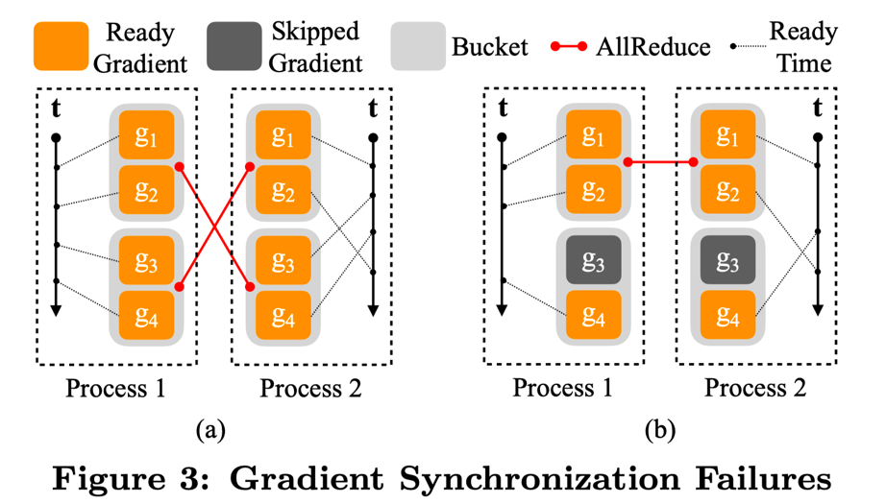
Distribution Data Parallel, DDP
Adopted multi process parallelism, not restricted by GIL.
Parameters of each process are not synchronized, but the change of parameters.
Using Ring all Reduce improves the communication efficiency.
Notes:
各进程不同步参数而是同步参数的变化量

Slide 17
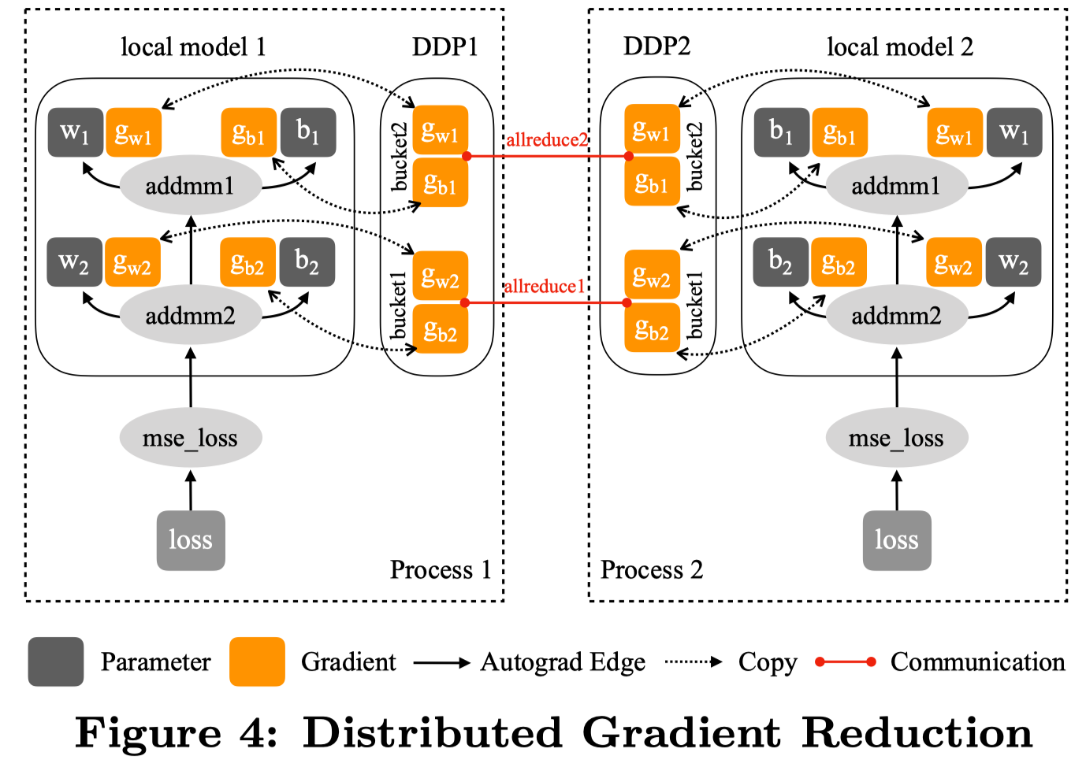
Distribution Data Parallel, DDP
gradient bucket
keep reduce order
skip gradient
Collective communication
Notes:
gradient分桶
计算通信重叠1-keep reduce order

Slide 18
Distribution Data Parallel, DDP
gradient bucket
keep reduce order
skip gradient
Collective communication
https://pytorch.org/docs/stable/notes/ddp.html
Notes:
gradient分桶
计算通信重叠1-keep reduce order

Slide 19
Collective communication

Slide 20
Model’s States

Slide 21
Fully Sharded Data Parallel, FSDP
FSDP shards all of model’s parameters, gradients and optimizer states across data-parallel workers and can optionally offload the sharded model parameters to CPUs.

Slide 22
Fully Sharded Data Parallel, FSDP

Slide 23
PyTorch Implication

Slide 24
Inference
https://zhuanlan.zhihu.com/p/450854172 全网最全-超大模型+分布式训练架构和经典论文
https://pytorch.org/blog/introducing-pytorch-fully-sharded-data-parallel-api/
https://pytorch.org/tutorials/intermediate/FSDP_tutorial.html
https://engineering.fb.com/2021/07/15/open-source/fsdp/
Li, Shen, et al. "Pytorch distributed: Experiences on accelerating data parallel training." arXiv preprint arXiv:2006.15704 (2020).
Xu, Yuanzhong, et al. "Automatic cross-replica sharding of weight update in data-parallel training." arXiv preprint arXiv:2004.13336 (2020).

Slide 25
Notes:
25

